Slide 1

Kasey Myers: Code Review
CS-499 Computer Science Capstone code review

Slide 2
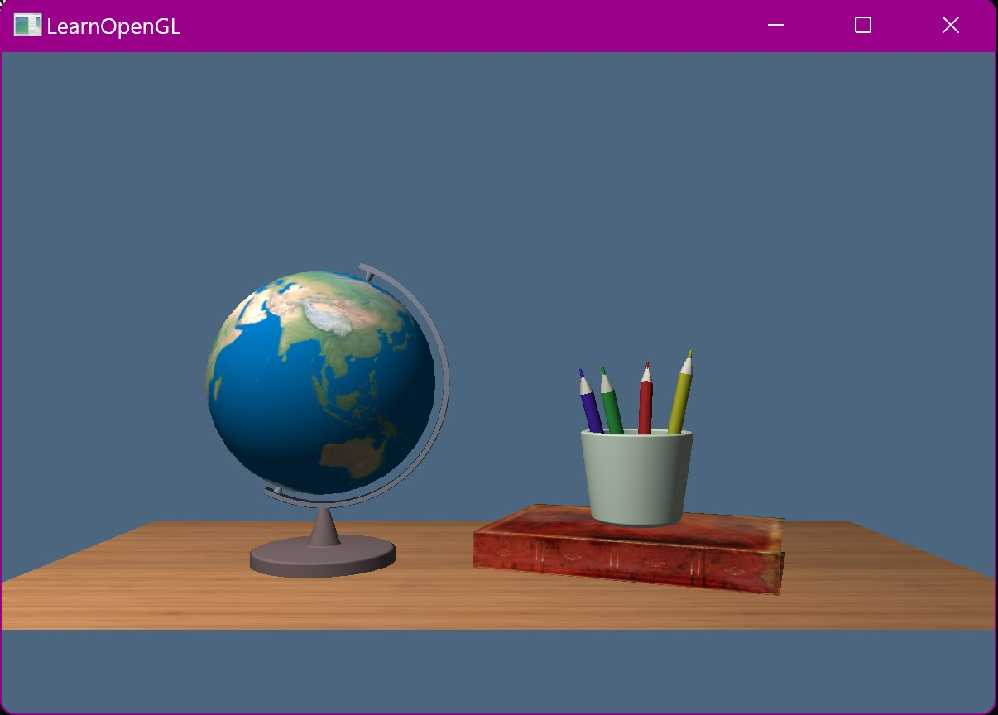

Artifact: CS-330 final project
CS-330 Computer Graphics and Visualization
OpenGL and C++
Create a 3D scene from a 2D picture or sketch

Slide 3
Core Competencies
Software Design
And Engineering
Algorithms and
Data Structures
Databases

Slide 4

Checklist
Structure
Documentation
Variables

Slide 5
Checklist continued
Arithmetic Operations
Loops and Branches
Defensive Programming

Slide 6

Thank You
kmyers0819@gmail.com

